Slide 1
3 x OMs… Study Circle & Self Transformation

Slide 2
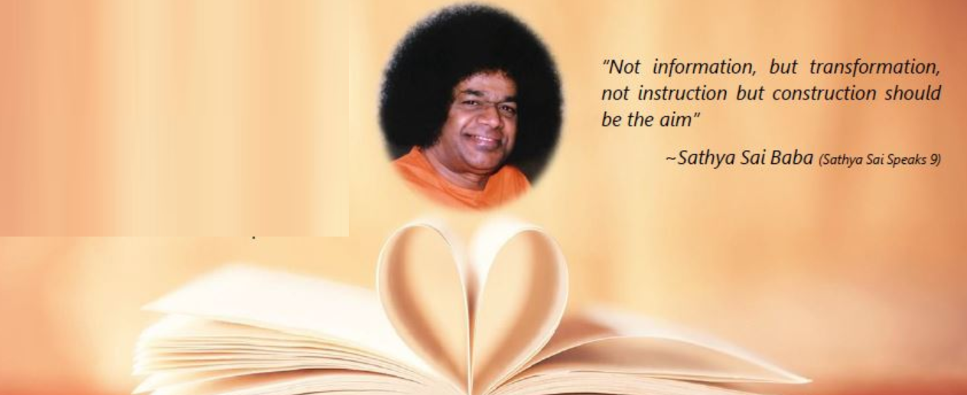
Om Sai Ram Study Circle
Circle of Karma

Slide 3
The Infinite Circle??

Slide 4
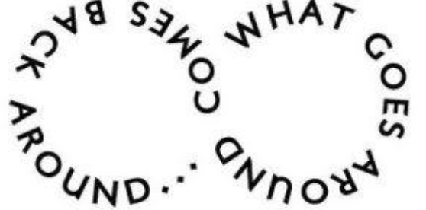
Why a Circle..

Slide 5
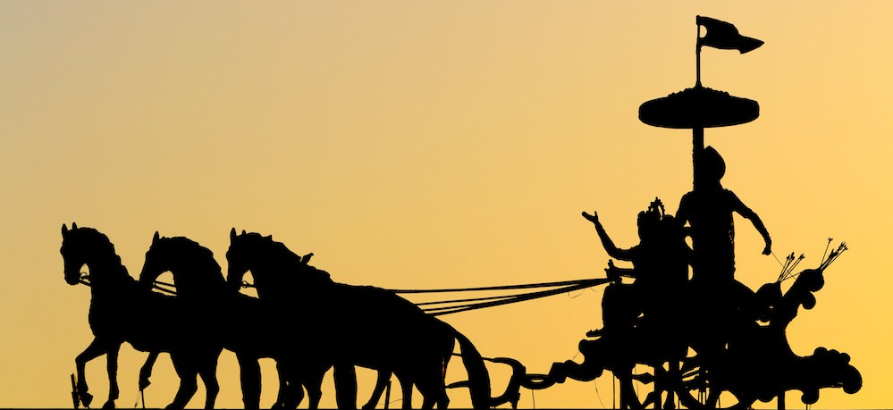
The Karmic Wheel...
Karmanye Vadhikaraste, Ma phaleshou kada chana, Ma Karma Phala Hetur Bhurmatey Sangostva Akarmani - Bhagavad Gita, Chapter II, Verse 47
You have the right to perform your actions, but you are not entitled to the fruits of the actions. Do not let the fruit be the purpose of your actions, and therefore you won’t be attached to not doing your duty.

Slide 6
The Karma Equation ??
How we are reborn depends on Karma...
Karma
Action
It quite simply means that our actions have consequences.
Positive actions have positive consequences.
Negative actions have negative consequences.

Slide 7
Karma
Good actions will bring you good karma.
Bad actions will bring you bad karma.
If you build up enough good karma in your lifetimes, you can be released from samsara and reach moksha.
This is a Spiritual person’s aim.

Slide 8
Wise Sayings From Different Faiths:
“God does not compel a soul to do what is beyond its capacity: it gets what it has earned, and is responsible for what it deserves.” Mohammed.
“Do not forget the debt you owe to the past, yet discern the signs of the age you live in, and be in harmony with it. Let not unthinking and blind traditionalism retard and arrest your progress.” Zarathushtra.

Slide 9
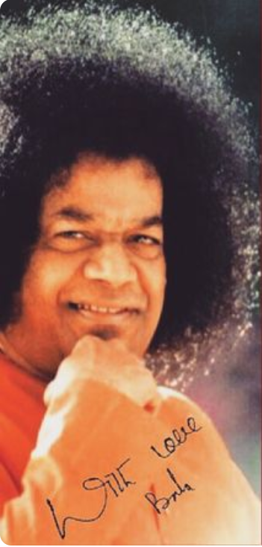
Swami Speaks
“Man’s life is erected on four walls: janma, karma, dharma, Brahmam (birth, actions, duties, and supreme reality, respectively). These four walls are interdependent and connected with each other. Why our birth took place (Janma)? It is to perform actions (Karma). How are actions to be done? Actions should be filled with righteousness (dharma). Through righteous actions, one should realize the supreme reality (Brahmam)”.
Bhagwan Sri Sathya Sai Baba

Slide 10
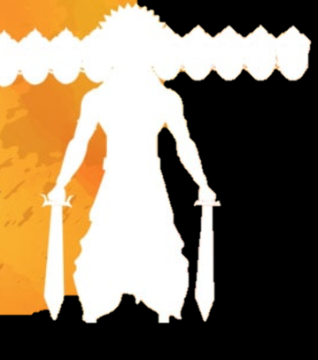
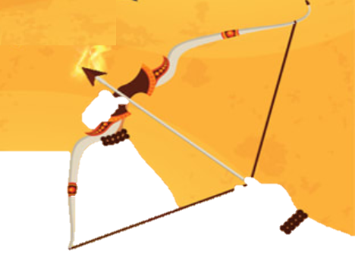
Learn from Mistakes…
Ravana vs Rama
"Ravana was one who was endowed with all wealth and prosperity. He lacked nothing in terms of comforts and luxuries. He had mastered the 64 categories of knowledge. His capital, Lanka, rivalled Swarga (heaven) itself in its grandeur. Instead of showing regard for Ravana, Valmiki extolled Rama, who gave up the kingdom, donned the robes of an ascetic and lived a simple life in the forest. What is the reason? It was because Rama was the very embodiment of Dharma. Everyone of his actions stemmed from Dharma. Every word he spoke was truth. Every step he trod was based on Dharma. Hence, Rama has been described as the very image of Dharma." Sai Baba, SS, 11/91. p. 298

Slide 11
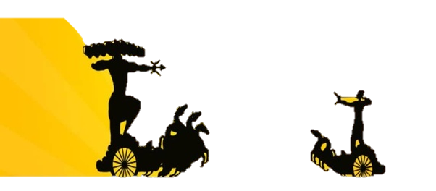
Inner Meaning Of Dasara
"The term' Devi' represents the Divine power which has taken the Rajasic form to suppress the forces of evil and protect the Satvic qualities. When the forces of injustice, immorality and untruth have grown to monstrous proportions and are indulging in a death-dance, when selfishness and self-interest are rampant, when men have lost all sense of kindness and compassion, the Atmic principle, assuming the Form of Shakti, taking on the Rajasic quality, seeks to destroy the evil elements. This is the inner meaning of the Dasara festival." Sai Baba. SS. 11/91. pp. 284 & 285

Slide 12
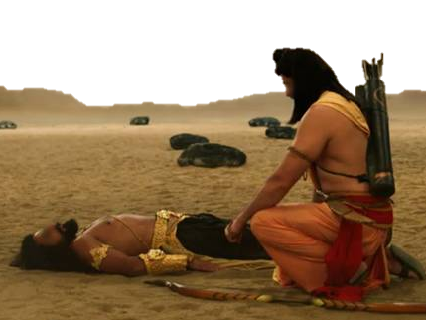
Teachings From Dying Ravana For Lakshmana
"When Ravana lay dying, Rama directed his brother, Lakshamana, to go to him and learn from him the secrets of successful statecraft. Ravana taught him that a king who is eager to win glory must suppress greed as soon as it lifts its head, and welcome the smallest chance to do good to others, without the slightest procrastination. He (Ravana) had learnt the lesson through bitter experience. Greed arises from attachment to the senses and catering to them. Put them in their proper place; they are windows for knowledge, not channels of contamination." Sai Baba, SS, 3/92, last cover page.

Slide 13
Summarize
SAMSARA IS THE CYCLE OF LIFE
REINCARNATION IS A RESULT OF PREVIOUS KARMA
KARMA RELATES TO ACTIONS AND THEIR CONSEQUENCES
MOKSHA IS LIBERATION FROM SAMSARA

Slide 14
Samsara and Karma Quiz
many
We don’t just have one life but ________.
Every living creature, including animals and plants, have a soul which is called the
________
Every living creature is ________, then ___________, then ____________ and
is _____________________. This is called ______________
This cycle of rebirth is called _________.
Eventually the soul will stop being reborn and will join with _______________.
This is the ultimate aim of a spiritual being and is called _________________.
Atman
born
lives
Dies
Reborn
Reincarnation
Samsara
Brahman
Moksha
Reincarnation Samsara Born Moksha Atman
Dies Brahman Lives Reborn Many

Slide 15
Practice for week – Be-Aware of your Karma
As you sow, so shall you reap." Your present state is the result of your past actions.
Therefore, start doing good acts in the present, & you must ensure beneficial results in the future.

Slide 16
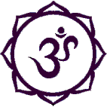
Closure
1 OM x 3 Shanti...

