Slide 1
Healthy communication
SsE HV Pittsburgh

Slide 2
Sense control
Speak no evil
Hear no evil
See no evil
Do no evil

Slide 3
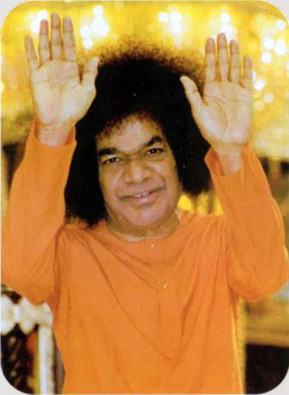
Controlling your tongue
Think before you speak
“Before you speak, ask yourself: Is it kind, is it necessary, is it true, does it improve the silence?”

Slide 4
The power of words
Have a lasting effect
Can be used to lift people up
Can be used to put people down
We have to do our best to make sure we never use words in a way that would be hurtful

Slide 5
How?
When you feel anger, hatred, ego, or pride…
Leave the situation
Sit in silence
Take deep breaths
Look into a mirror
Force a laugh or smile

Slide 6
How?
When you feel insulted/ put down…
Do not let your emotions take over
You have two choices:
Ignore what they said, do not let it affect you
Speak up in a respectful and careful manor
All that matters is who you are and how you believe in yourself, what others say cannot bring you down

Slide 7
Build bridges not fences
Do not add fuel to the fire
Better the situation if possible

Slide 8
Role play
Acting out different real life scenarios
How to appropriately handle each one

Slide 9
communicating
Never start sentences with “you” instead replace them with “I”
Use phrases such as
I feel… when you…
I need you to…
I am willing to… in exchange
Communicating effectively
Not directly attacking the other person
Compromise is key

Slide 10
Basic guidelines
Keep to the current moment
Use “I” statements
Deal with conflict
Take a break if necessary

Slide 11
SAI Ram
“God, grant me the serenity to accept the things I cannot change, the courage to change the things I can, and wisdom to know the difference.”

