Slide 1
3 x OMs… Study Circle & Self Transformation

Slide 2
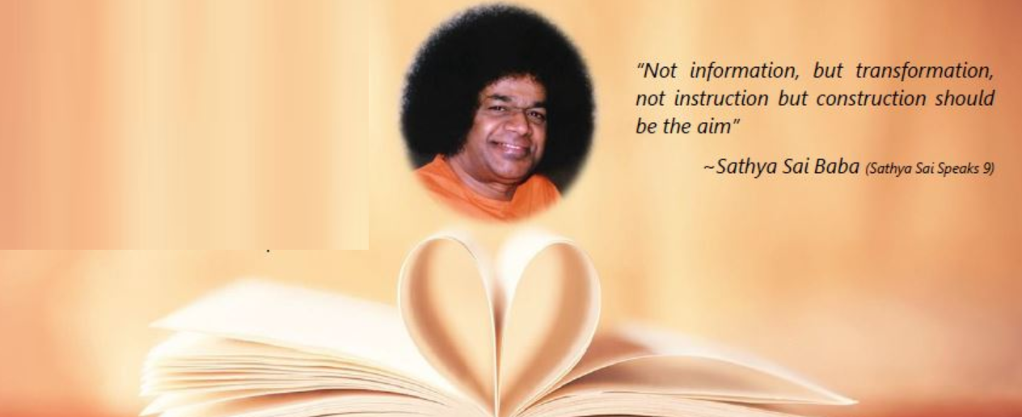
Om Sai Ram Study Circle
Coping With Mental Worries & Anxieties

Slide 3
I am not the expert, Swami is…

Slide 4
The Anxiety Equation ??
OH YES,
there is an equation for anxiety and you don’t have to be a mathematician to understand it.
-ve Thinking x Time = Worry
Worry x Time = Anxiety

Slide 5
What is Worry ??

Slide 6
Let’s converse (Etiquettes - Ladies first)
Devotee
“I am mentally restless, Swami, because I yearn for rest and do not get it”.
Swami says
“It is your reaction to restlessness that is bad, not the restlessness itself. Restlessness is only the rise and fall of a wave on the ocean that you are. Nothing matters, so long as the depths are secure.
Success is not important & failure does not matter. The river of eternity is flowing ever into the ocean of the Supreme Will”.
Share a thought…

Slide 7
Let’s converse
Devotee
“Swami! Sometimes I feel so sad that I am so strange, so different in habits from the rest of those that come to you for succor”. (succor: support)
Swami says
“If your path contrasts entirely with those around you, believe that it is my will for you. Every way is my way and ways seemingly indirect may be the most direct for some spiritual seekers. For me there are no impossible cases, no incorrigible cases. Practice choicelessness, as hitherto prescribed. Choicelessness, is constant contentment”.

Slide 8
Let’s converse
Devotee
“What then is the proper reaction to the attractions of the world”?
Swami says
Let go. Don't cling. Be still. Establish yourself in the homelessness of the mind; physical homelessness will not earn the victory. There are many spiritual aspirants still caught in the coils of greed, envy, pride and power seeking. They have not escaped from their homes. They have built prisons around themselves. I describe homelessness of the mind as mind abiding nowhere.

Slide 9
Let’s converse
Devotee
“I find it difficult to hold my attention on form or word”.
Swami says
“Because when you try to meditate, the very trial invites the success-failure conflict onto the scene. You say to yourself, it is good to meditate on this and not that, or to meditate on that is wrong or foolish. Practise choicelessness; no objective, no intention. Be yourself. Choose no particular form, for all are equally His. Choose no particular word or sound, for all are His”.

Slide 10
Let’s converse
Devotee
“What then shall be my direction?”
Swami says
“Take what works today for today. What works tomorrow, leave for tomorrow. One day at a time, each day for itself, each moment for itself, without a past, without memory, without conclusions.
Conclusions bind; they press on the mind. The newborn baby is not confined to conclusions. All conclusions enslave. Most men are slaves to the conclusions into which they have fallen”.

Slide 11
Let’s converse
Devotee
“Is Ignorance really a bliss - if I do not know about something, then I do not worry about it”?
Swami says
“Give each problem the attention it deserves; but do not allow it to overpower you. Anxiety will not solve any difficulty; coolness comes from detachment. Above all, believe in God and the efficacy of prayer. The Lord has said that he who does good, thinks good, and speaks good will not come to harm. That is the way to get equanimity & peace (shanti)”.

Slide 12
Let’s converse
Devotee
“Baba, how can one learn to Be in you and think as You do?”
Swami Says
“Being in Me means to be Me! Therefore, the flow and the essence of your thoughts must correspond to this. I suggest that you master broad-thinking — thoughts flow easily, smoothly, and calmly and become manifested from the Depth on the physical plane.
Learn from Me — to love, to think, to act! The lower self must be substituted with the Higher Self — with your True, Divine Self, Which is coessential to the Self of God.

Slide 13
Devotee : Swami, I am addicted to tea drinking, which hurts me. How can I stop this practice?
Swami says
“Heaven is not refused to those who drink tea! A rajasic person is rendered hyperactive by tea, but to an invalid it is a welcome lift. But do not adore tea as the only reality. Now with regard to these habits that have gripped you, there are two methods by which you can discard them. The first is deprivation, denial. This can yield only temporary success. When one's determination relaxes, the habit reasserts itself and it becomes difficult to resist. The second method is to become so absorbed in something far more pleasing that the habit falls off by itself. Remember, what is transient is not important. What is important is eternal. My prescriptions are varied; they differ from person to person, from stage to stage, even in the case of the same person. All prescriptions work. Let people come to me through Bhajan, through Japa, through Meditation, through Mantras, through Tantra or Seva ? as I ordain. Every one will come to me; everyone has to come to me. There are no exceptions”.

Slide 14
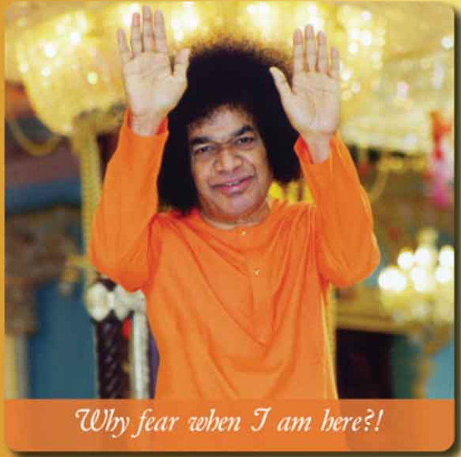
Is there a solution ??
Yes, recap the Assurance “ Why fear When…

Slide 15
Questions
If we are never free from anxiety in this life, How can we live our lives to the fullest and utilize the human birth gifted to us.
What is the source of anxiety and restlessness? What should we do to be happy and escape misery?
Practice for the week
Give the problem the attention it deserves and keep calm.

