Slide 1
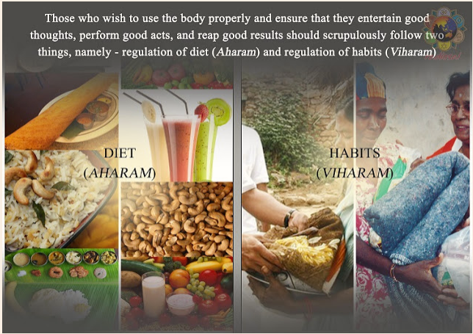
Food And Health

Slide 2
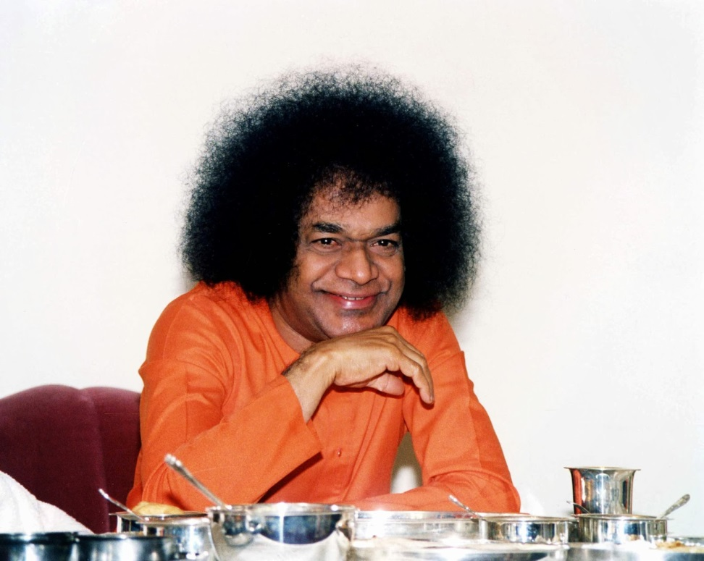
Food for Thought
What is food?
Why is food important for physical and mental health?

Slide 3
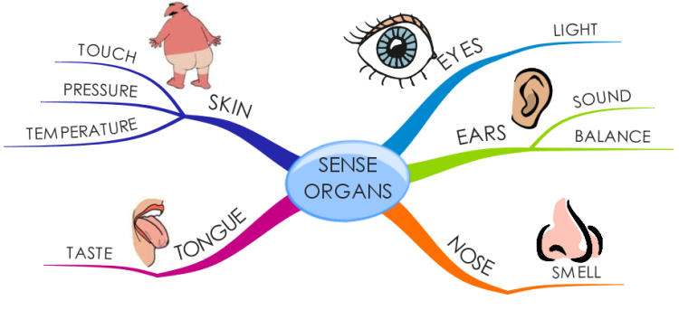
The body has five sense organs and if you take Satvic food only for one of the organs, then it is of no use. You should take Satvic food from all the sense of organs, which means we must always speak Satya or truth, hear only what is good, feel good, see good and smell only what is good to smell.
You should see only that which is good and which leads to good thoughts. Sight, which is of a sacred nature, is the intake of Satvic food through the eyes. Hearing good things forms the intake of Satvic food through the ears.
One should avoid going to places where there is bad odor, and try to inhale fresh air and breathe freely. Righteous deeds performed by the hand constitute the intake of Satvic food through the hands. The body is said to be the temple of God only when we intake Satvic food through all our sense organs. We must also be careful about the places we visit and the company we keep. Your thoughts and actions will depend upon your company.
https://sathyasaiwithstudents.blogspot.com/2015/05/what-is-good-food-for-human-body.html

Slide 4
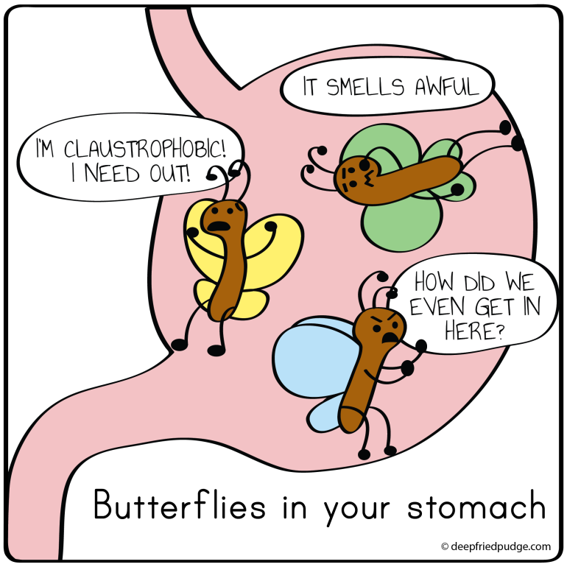
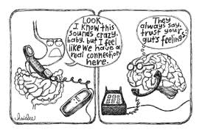
Food for Thought (,Word and Deed)
Can you give an example of when wrong types of food have adversely affected your physical, mental and spiritual state?
How can we implement the “Satvic (pure, balanced, ideal) Food” principal in our daily lives?

Slide 5
"The food consumed by man should be proper, pure and wholesome. But nowadays people eat whatever they get and wherever they get it, and thereby spoil their health. Food plays a major role in the preservation of health. Care should be taken to see that the food consumed does not have much fat content, for the fats consumed in large quantity are detrimental not only to one's physical health but also to one's mental health." (Sathya Sai Speaks. Vol.27, Chapter 3) "By regulating your diet and avoiding certain bad habits, you can preserve health. Moderate food, and food of the Satvic type, will promote mental poise and also physical happiness... Many people consume more than necessary quantity of rich food and such have to practice moderation." (Sathya Sai Speaks. Vol.1, Chapter 28)

Slide 6
"Food habits are of primary importance when health has to be secured and maintained. When these are not regulated, health suffers...Among the eight million four hundred thousand species of living beings, all except humans live on food as provided by Mother nature.... one should realize that food materials, as offered by nature, are really more beneficial." (Sathya Sai Speaks. Vol.15, Chapter 54)

Slide 7
You should not take whatever you like whenever you are hungry. You should always take Satvic food. The type of smoke emanating from fire will depend on the type of fuel used, the clouds will depend on the type of smoke, the water depends upon the type of clouds, the rain depends upon the type of water, the crop depends on the type of rain, the food depends upon the type of crop, the thoughts in the head depend upon the food which you have eaten. All thoughts, whether good or bad, depend upon the food you take.

