Slide 1
Emotions Anger (Re-cap) Sai Speaks On Controlling Anger

Slide 2
Emotions Patience

Slide 3
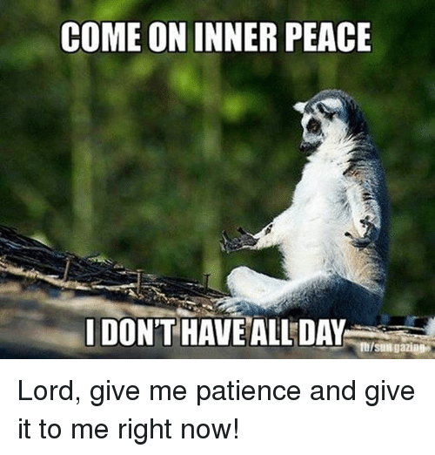

Slide 4
Patience - Quote
When there is patience and humility, there is no anger, nor even irritation. ( St. Francis of Assisi)

Slide 5
PATIENCE BRINGS REWARDS
I always act calmly. I never hurry. I do say, "Let it be so", to every request of yours. You have come into this world to reach the Lord. Ignorant of that purpose, you have hoisted on your head the weight of illusion and you are struggling to unload it, suffering under its weight. What is the use of running after external pleasures and temporary joy? So long as you are caught in this ignorance you can never taste the Bliss of Realisation; you cannot even recognize it much less attain it. But, if you are patient and calm, I shall grant you joy without fail. Do not yield to despair. Even the infant lotus buds will bloom, in their own good time. By the cumulative effect of the good done in many previous births, you have secured this fortune; you do not know how much you have gone through, but, I know! And, whether you know or not, I shall certainly give you your need. (SSS Vol.2 1961 117)

Slide 6
Whatever be the circumstances we confront, we should not get excited or agitated. We should allow time for the nobler feelings to well up from inside us and manifest themselves. By practising patience and forbearance we will be able to acquire all the other important spiritual qualities, such as mind control, faith, renunciation, endurance and concentration. This will bring a state of inner purity and fill us with abiding peace. (SS June 87, 162)

Slide 7
CULTIVATE PEACE
One should cultivate patience, which is not commonly done in the present-day life. Haste makes waste, waste begets worry. So one should develop patience to avoid worry. Our mind is compared to the moon; when thoughts arise it is eclipsing the real nature just as the moon is eclipsed by the shadow of the earth. If you keep the heart pure of all the malaise of evil qualities, you will have no worry at all. You should not allow wicked thoughts to stick to you. In a pond, along with lotus flowers that bloom, you have leeches also thriving, which suck your blood. The lotus cannot sustain itself without water. So also human life cannot sustain itself without love. But you should not let the leeches of worry breed in your heart of love. You can travel in a boat on the surface of water but should not allow water to enter into the boat. You should not allow the attachment to worldly objects to enter into your boat of life. - Discourse(160498)

Slide 8
In the days of yore, people did not have many material comforts, but they led an exalted life by cultivating firm self-confidence in the light of Atma Jyoti (radiance of the soul). In this Kali Age, science and technology have made great progress. Modern man has acquired wealth, comforts and prosperity. There is no dearth of people with riches, knowledge and intellect. But still there is no peace in the family and society. The reason for this is a lack of patience and sympathy amongst the members of the family living in a house. These two values are not seen in any family today. Why does man lack these two qualities? A rise in selfishness and the use of intelligence for one's own self-interest have brought about this decline. Because of this man is ruining his sacred life. (021000)

Slide 9
Patience and Tolerance, are they the same? Is one better than the other or can one be developed in the absence of the other?

Slide 10
Patience – ability to endure pain
It is an event – Yes , it is painful right now, let us wait and watch.
Barometer for spiritual progress – Are you more patient ? Or you more accepting ?
How can we be patient and strive at the same time?

Slide 11
PATIENCE IS AN IDEAL QUALITY
Patience is an ideal quality one should develop. Whatever troubles or obstacles one may meet with while doing his proper duty, he should bear with them. One should not get depressed when others blame or abuse him but should stick to the path of truth. (191093)
Patience or forbearance is one of the most important characteristics that every person should practise and possess. Many kings have been destroyed because they abandoned this quality of patience. Even great Rishis have lost all their spiritual merit because they neglected this quality. Countless scholars have come to ruin because they overlooked this invaluable characteristic. Patience can be thought of as the most important shield and armor for facing the battle of life. Human beings quickly lose all their human qualities if they lose patience. As you have already seen, the quality of patience is an extremely important sign of Stithaprajna, a great person possessed of abiding wisdom; without patience it would not be possible to become or remain a Stithaprajna. (DBG 33 238)

Slide 12
Conversation With Swami
Tell us please about the Divine patience. How can one gain it?”
“Patience is the foundation of calm, the basis of the true ability to work creatively. The more patience you have, the more you can achieve in all areas of life, and of course — in cognition of Me.
“Patience must not be passive: what use is it to be patient doing nothing? No, the true patience is an active state.
“One must patiently, step by step, reform in oneself all the defects of the soul, reform oneself in accordance with the ethics of God. In the process of this work, one gains the Divine Patience.
“Patience is also necessary for understanding of other people. One has to learn to understand other people! Without such understanding one cannot help them!

Slide 13
A resolute nature -- in other words, the quality of determination and being endowed with a firm resolve -- is the precondition for developing patience. Now a resolute nature should not be associated with a stubborn foolishness. In sacred tasks, in matters relating to the spirit, man’s firmness and resolute nature may be described as a quality of the mind which is free from delusion and waveriness. Whatever obstacle is encountered, whatever troubles and problems arise, a man with a resolute nature remains firmly committed to pursuing the tasks which he has undertaken until he achieves his final goal. If you do not have this quality of determination, then patience will have no basis and cannot develop in strength. Patience and determination are twins; one cannot exist without the other, Without determination, patience cannot establish itself, and without patience, determination will degenerate into arrogance. (DBG 33 238)

Slide 14
In this video , Prof, R.Kumar Bhaskar, Former Head, Department of management and Commerce, Sri Sathya Sai Institute Of Higher Learning , Prashanthi Nilayam Campus , shares how Swami taught him and his family the lesson and value of patience.
Link

